Slide 1

Reinforcement Learning Course
Dr. Benny Bornfeld

Slide 2

Topics
Topics
Explore Vs Exploit
Basic Terminology and Concepts
Exact Solution Methods (Tabular Methods)
Approximate Solution Methods
Learning and Testing Environments
Course Learning Objectives
Course Prerequisites
Course Assignments
Course Test
Course Project

Slide 3

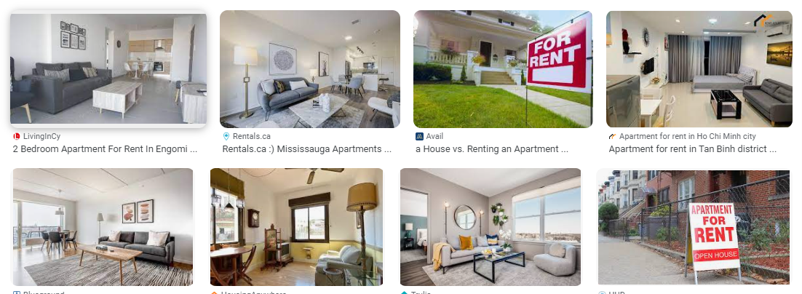
Explore vs Exploit Riddle
You get to a new city, looking to rent the best apartment for you, well defined based on combination of price, size, light, renovated, …
There are a total of 100 apartments for rent
You got an unordered list of the 100 apartment and you see them one by one with no upfront knowledge.
Each time you see an apartment you can choose to take it or not. If you chose not to take it, you can not take her later.
What is your strategy to find the optimal apartment?

Slide 4

RL Basic Terminology

Slide 5
Exact Solution Methods
Dynamic Programming
Tabular Q-learning
Tabular SARSA
Monte Carlo methods
Time Difference Methods

Slide 6
Approximated Solution Methods
Deep Q-Learning
Policy Gradient Methods
Actor-Critic Methods
Proximal Policy Optimization

Slide 7
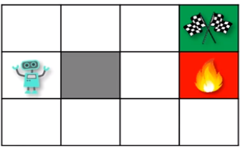
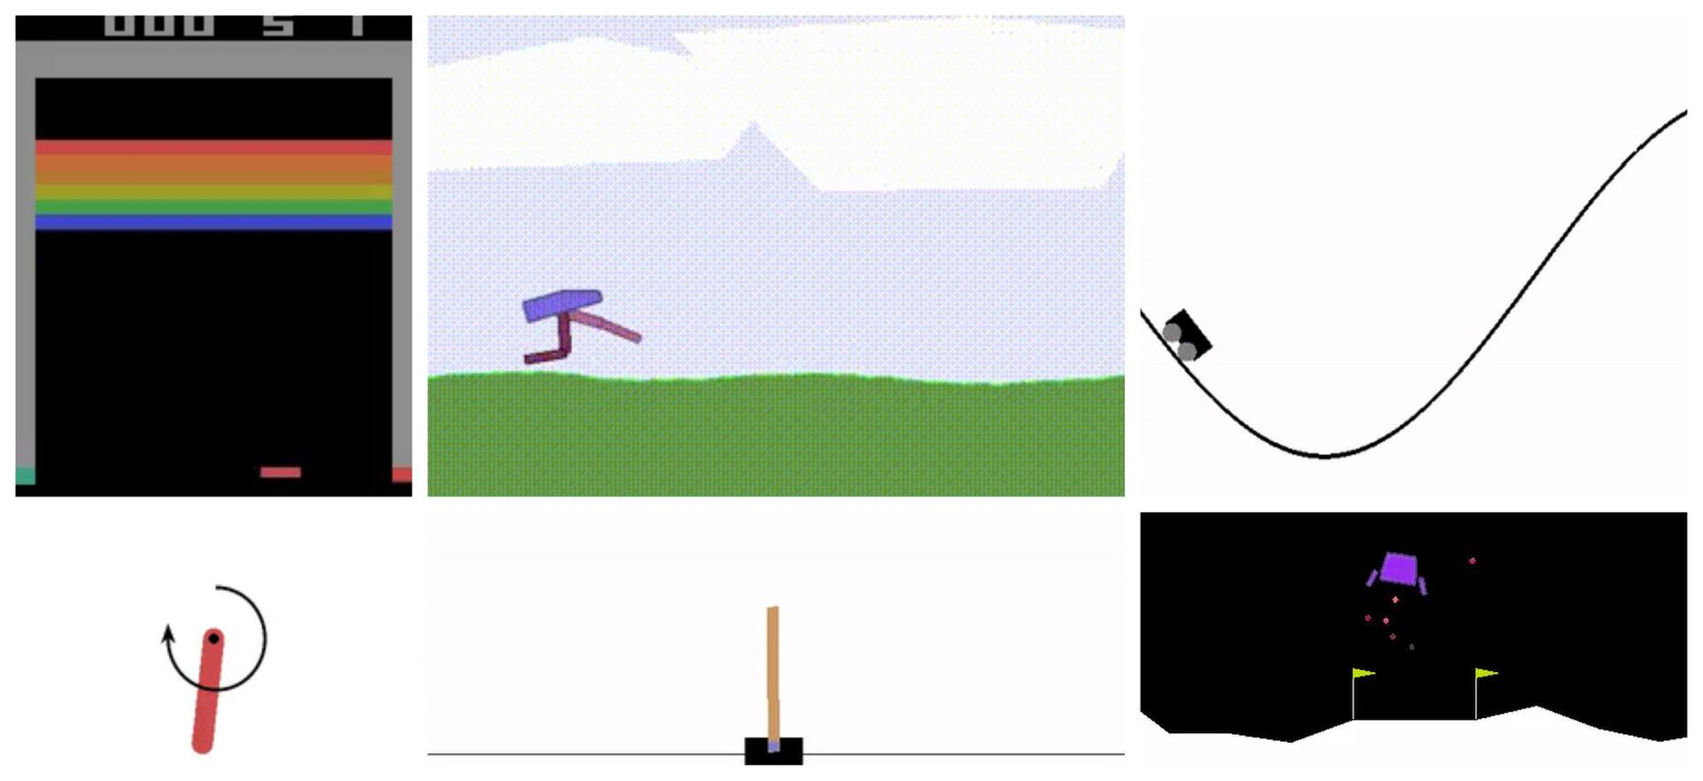
Basic Learning and Testing Environments
Grid World
OpenAI Gym

Slide 8
Learning Objectives
Understand
Understand core RL concepts and terminology
Implement
Implement basic RL algorithms from scratch
Apply
Apply RL techniques to solve real-world problems
Evaluate and compare
Evaluate and compare different RL approaches
Design and conduct
Design and conduct RL experiments

Slide 9
Prerequisites
Basic Python programming
Probability and Statistics
Linear Algebra
Calculus
Machine Learning fundamentals

Slide 10
Course HW Assignments (20%)
Explore vs Exploit (Dry Run, code)
Exact Solution Methods (Dry Run, Code)
Approximated Solution Methods (Code)

Slide 11
Test (40%)
Terminology and Basic Concepts
Exact solution methods

Slide 12
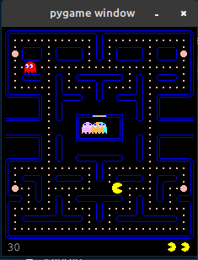
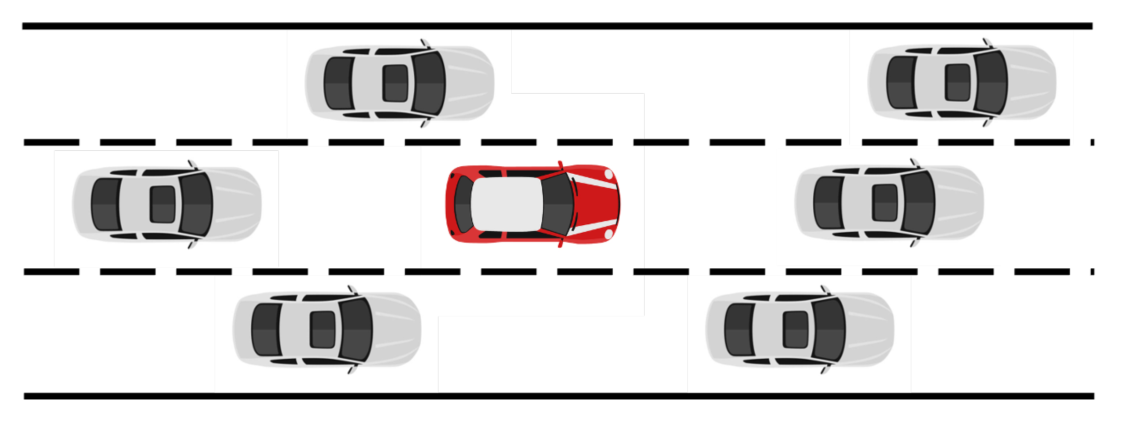
Project (40%)
Project are done in teams
You are required to defend your project

Slide 13


